Slide 1
Services in the Economy
Chapter 1

Slide 2
Why Study Service Operations
Service firms are a large percentage of the economies of industrialized nations
  80% of the US economy (employment and GDP)
Gain a competitive edge. There is little focus on services in the academic world
Not all management tools that are appropriate for manufacturing are transferable into a service environment

Slide 3
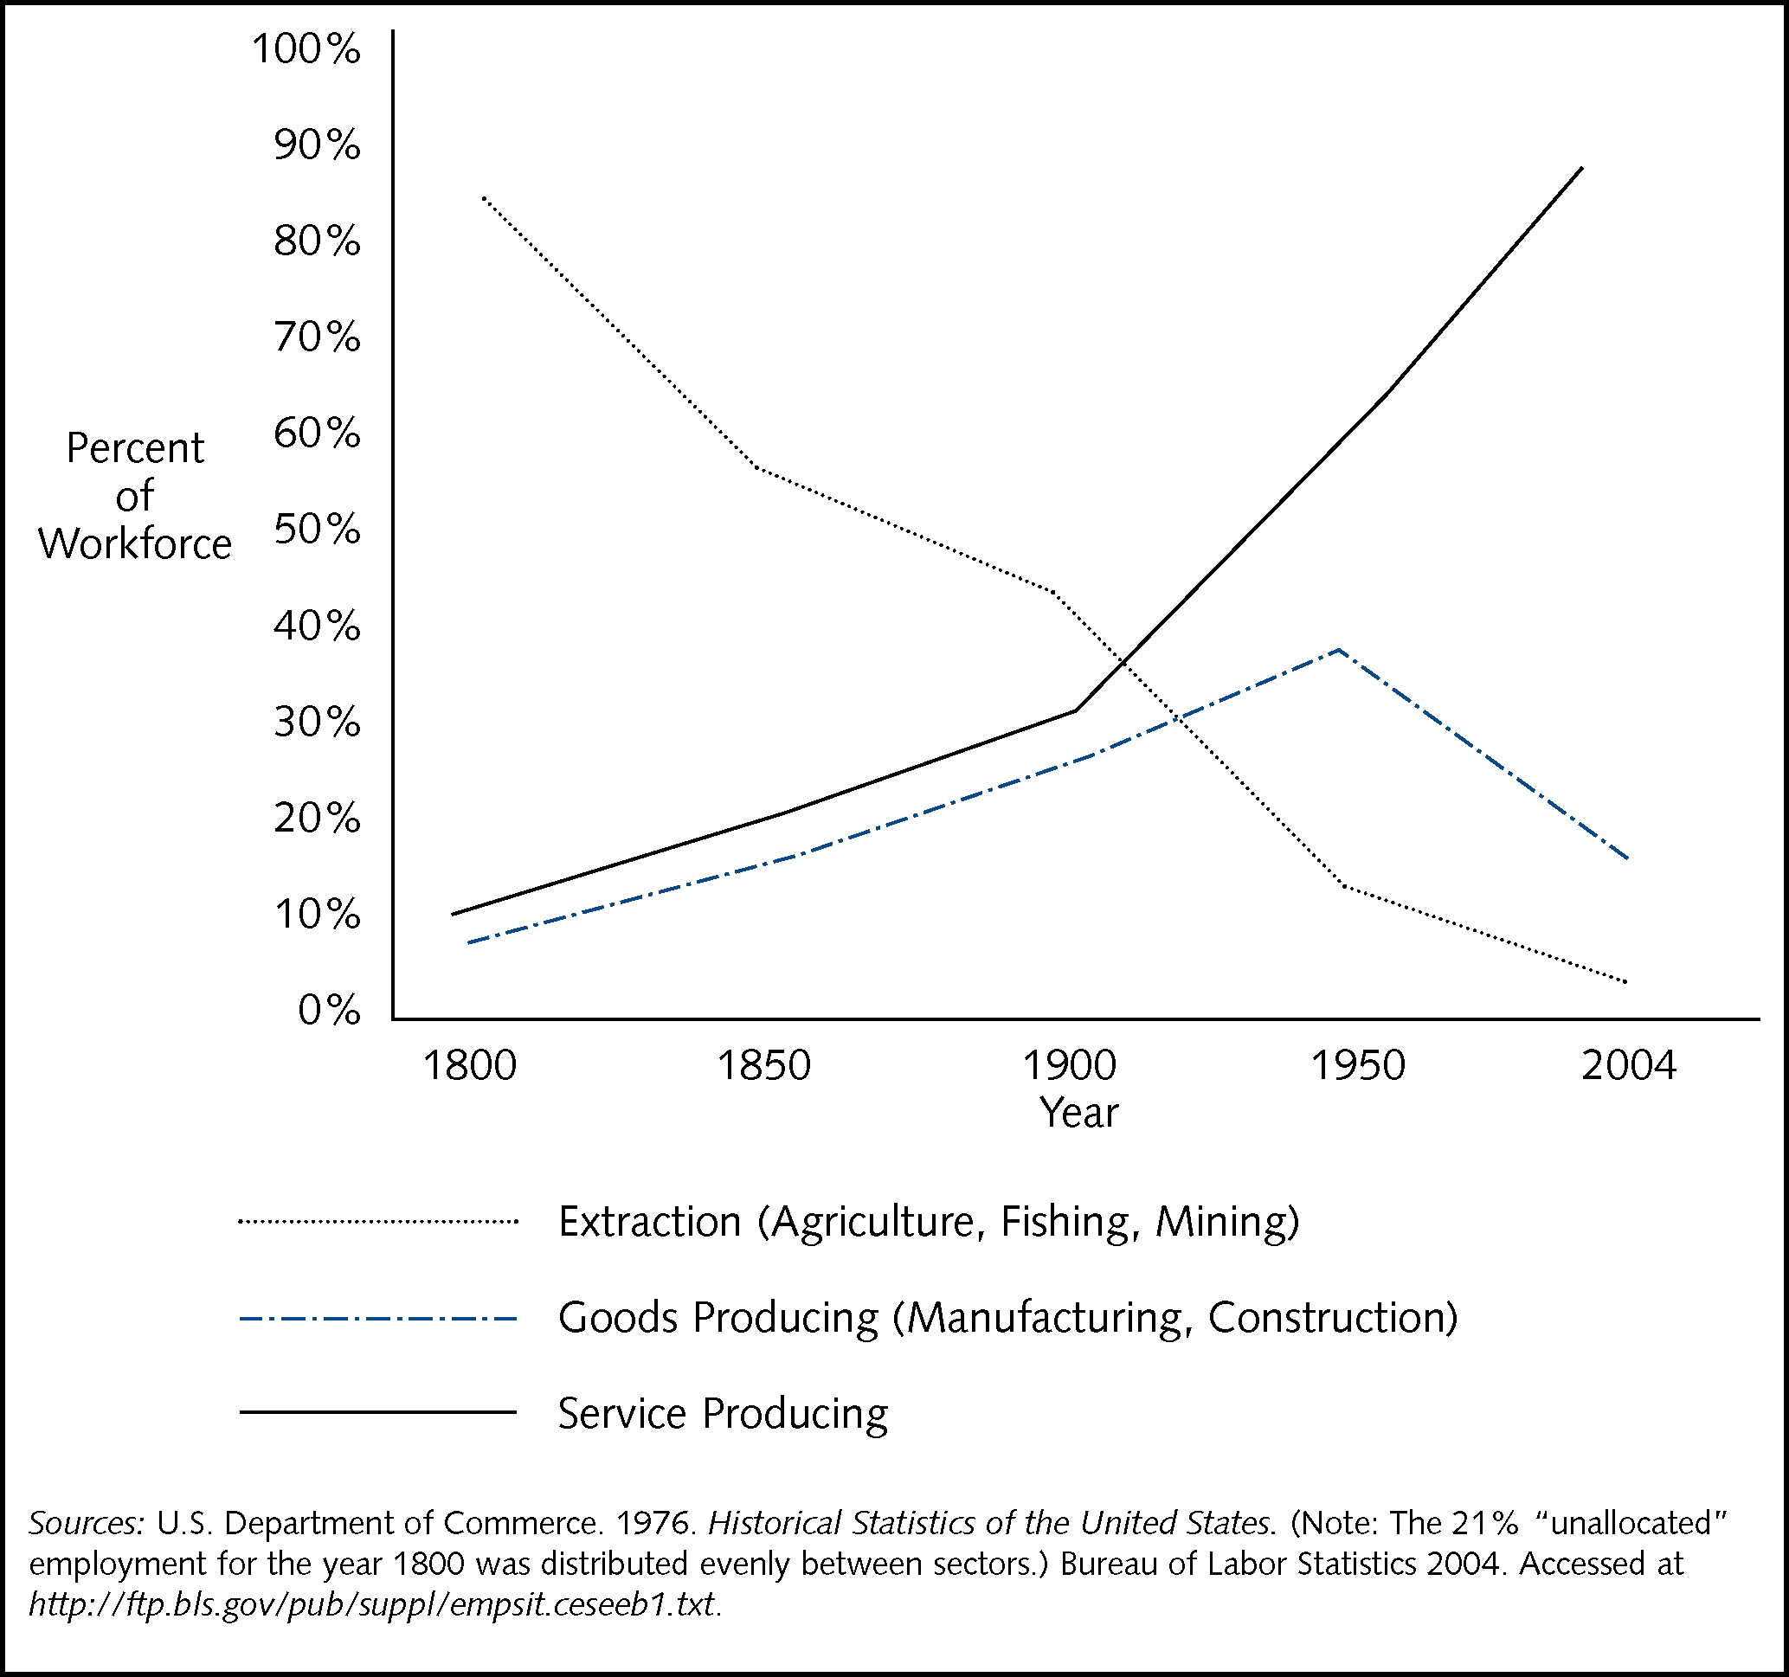
Historical US Employment by Economic Sector
Chapter 1 - Services in the Economy

Slide 4
What is Operations?
The transformation process that turns inputs into outputs, that is, the act of combining people, raw materials, technology, etc. into useable services and products
Who is in the operations function?
  The people who actually make a product or perform a service
  Typically operations has the largest number of employees of any functional area

Slide 5
But I’m going into marketing, finance, strategy…
Regardless of your functional area, you will be involved in “transformational processes”, in other words, “getting things done”
Service operations can help you get things done more effectively and more efficiently.

Slide 6
Characteristics of services …
Rules:
  Services are intangible
  Simultaneous production and consumption
  Proximity to the customer
  Services cannot be inventoried
Exceptions:
  Facilitating goods: playbills, groceries
  Computer system upgrades; janitorial services
  Internet-based services; catalogs
  Retailers hold inventory; hotel rooms, airline seats are inventory

Slide 7
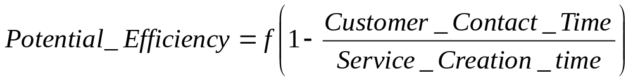
Customer Contact Model
Services are classified according to the amount of customer contact
Pure Services
Mixed Services
Quasi-Mfg.
Manufacturing
Medical
Restaurants
Transportation
Branch offices
Home offices
Distribution centers
  Guiding Principle:

Slide 8
Service Process Matrix
Degree of Interaction and Customization
Degree of Labor Intensity
Low
High
Low
Service Factory
Airlines
Trucking
Hotels
Service Shop
Hospitals
Auto Repair
Other Repair Services
High
Mass Service
Retailing
Wholesaling
Schools
Retail Aspects of Commercial Banking
Professional Service
Doctors
Lawyers
Accountants
Architects

Slide 9
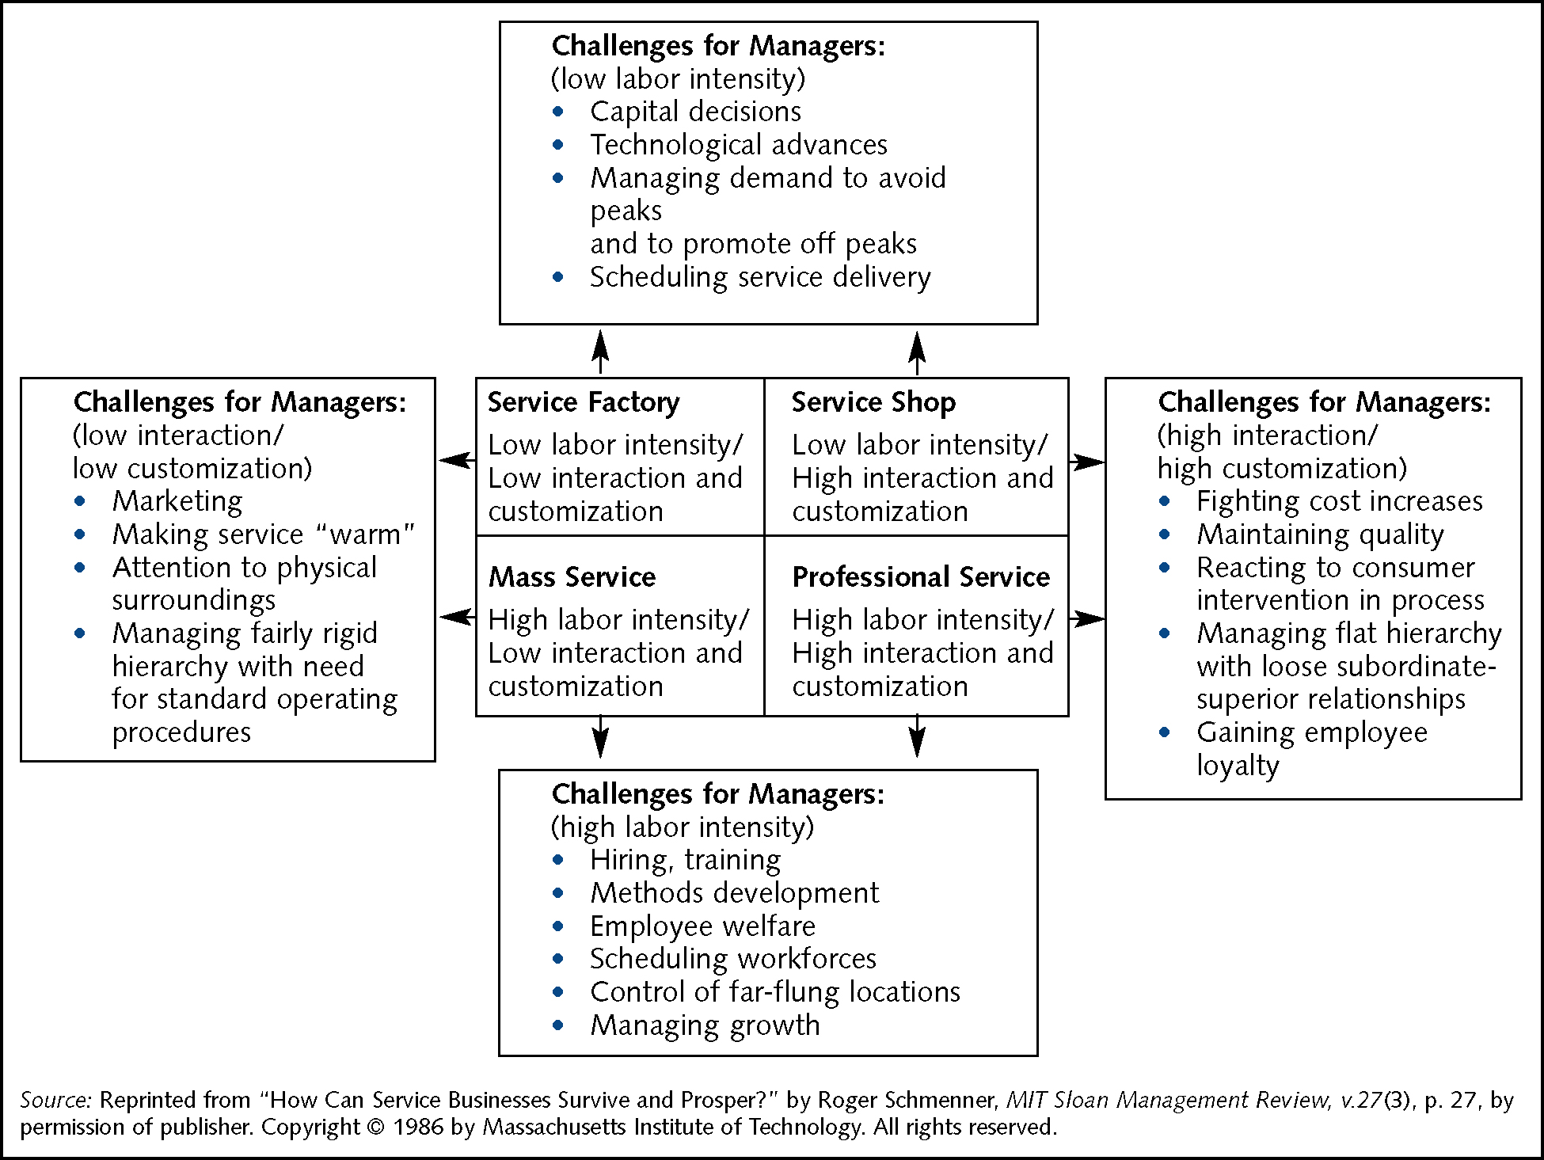
The Service Process Matrix: Challenges for Service Managers

Slide 10
Low Labor Intensity
Challenges for managers
  Capital decisions
  Technological advances
  Managing peak/non-peak demand
  Scheduling service delivery

Slide 11
High Labor Intensity
Challenges for managers
  Hiring, training
  Methods development
  Employee welfare
  Scheduling workforces
  Control of far-flung locations
  Managing growth

Slide 12
Low Interaction/Customization
Challenges for managers
  Marketing
  Making service “warm”
  Attention to physical surroundings
  Managing fairly rigid hierarchy with need for standard operating procedures

Slide 13
High Interaction/Customization
Challenges for managers
  Fighting cost increases
  Maintaining quality
  Reacting to consumer intervention in process
  Managing flat hierarchy with loose subordinate-superior relationships
  Gaining employee loyalty

Slide 14
Chapter Summary
Service firms constitute an overwhelmingly large percentage of the economy.
Despite the size, a lack of attention given to services provides a competitive advantage to those students who pursue its study.
Moreover, specialized and different managerial techniques are employed in services.

